Slide 1
Lecture 10: Link analysis
[Borrows slides Pandu Nayak and Prabhakar Raghavan]

Slide 2
Today’s lecture – hypertext and links
We look beyond the content of documents
  We begin to look at the hyperlinks between them
Address questions like
  Do the links represent a conferral of authority to some pages? Is this useful for ranking?
  How likely is it that a page pointed to by the Stanford home page is about high education?
Big application areas
  The Web
  Email
  Social networks

Slide 3
Links are everywhere
Powerful sources of authenticity and authority
  Mail spam – which email accounts are spammers?
  Host quality – which hosts are “bad”?
  Phone call logs
The Good, The Bad and The Unknown
?
Good
?
?
Bad
?

Slide 4
Simple iterative logic
The Good, The Bad and The Unknown
  Good nodes won’t point to Bad nodes
  All other combinations plausible
?
Good
?
?
Bad
?

Slide 5
Simple iterative logic
Good nodes won’t point to Bad nodes
  If you point to a Bad node, you’re Bad
  If a Good node points to you, you’re Good
?
Good
?
?
Bad
?

Slide 6
Simple iterative logic
Good nodes won’t point to Bad nodes
  If you point to a Bad node, you’re Bad
  If a Good node points to you, you’re Good
Good
?
Bad
?

Slide 7
Simple iterative logic
Good nodes won’t point to Bad nodes
  If you point to a Bad node, you’re Bad
  If a Good node points to you, you’re Good
Good
?
Bad
Sometimes need probabilistic analogs – e.g., mail spam

Slide 8
Many other examples of link analysis
Social networks are a rich source of grouping behavior
E.g., Shoppers’ affinity – Goel+Goldstein 2010
  Consumers whose friends spend a lot, spend a lot themselves
http://www.cs.cornell.edu/home/kleinber/networks-book/

Slide 9
Our primary interest in this course
Analogs of most IR functionality based purely on text
  Scoring and ranking
  Link-based clustering – topical structure from links
  Links as features in classification – documents that link to one another are likely to be on the same subject
Crawling
  Based on the links seen, where do we crawl next?

Slide 10
The Web as a Directed Graph
Sec. 21.1
Page A
Page B
hyperlink
Anchor
Assumption 1: A hyperlink between pages denotes a conferral of authority (quality signal)
Assumption 2: The text in the anchor of the hyperlink describes the target page (textual context)

Slide 11
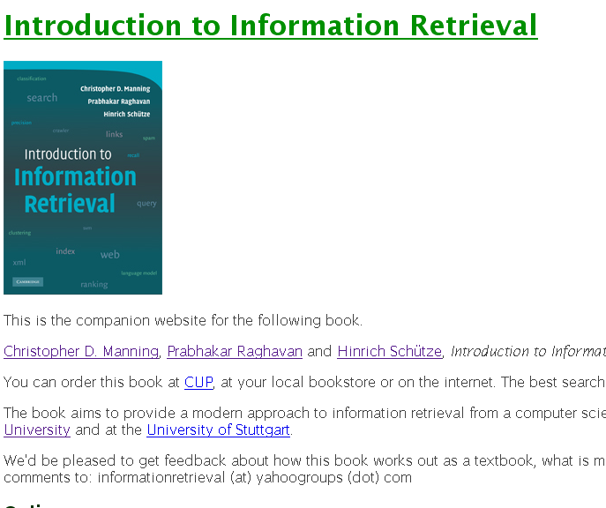
Assumption 1: reputed sites

Slide 12


Assumption 2: annotation of target

Slide 13
Anchor Text
WWW Worm - McBryan [Mcbr94]
Sec. 21.1.1
For ibm how to distinguish between:
  IBM’s home page (mostly graphical)
  IBM’s copyright page (high term freq. for ‘ibm’)
  Rival’s spam page (arbitrarily high term freq.)
“ibm.com”
“IBM home page”
“ibm”
A million pieces of anchor text with “ibm” send a strong signal
www.ibm.com

Slide 14
Indexing anchor text
Sec. 21.1.1
When indexing a document D, include (with some weight) anchor text from links pointing to D.
Armonk, NY-based computer
giant IBM announced today
www.ibm.com
Joe’s computer hardware links
Sun
HP
IBM
Big Blue today announced
record profits for the quarter

Slide 15
Indexing anchor text
Sec. 21.1.1
Can sometimes have unexpected side effects - e.g., evil empire.
Can score anchor text with weight depending on the authority of the anchor page’s website
  E.g., if we were to assume that content from cnn.com or yahoo.com is authoritative, then trust the anchor text from them

Slide 16
Anchor Text
Sec. 21.1.1
Other applications
  Weighting/filtering links in the graph
  Generating page descriptions from anchor text

Slide 17
Citation Analysis
Citation frequency
Bibliographic coupling frequency
  Articles that co-cite the same articles are related
Citation indexing
  Who is this author cited by? (Garfield 1972)
Pagerank preview: Pinsker and Narin ’60s

Slide 18
The web isn’t scholarly citation
Millions of participants, each with self interests
Spamming is widespread
Once search engines began to use links for ranking (roughly 1998), link spam grew
  You can join a group of websites that heavily link to one another

Slide 19
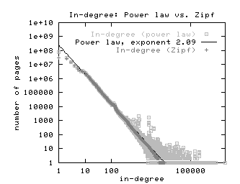
In-links to pages – unusual patterns ☺

Slide 20
Pagerank scoring
Sec. 21.2
Imagine a browser doing a random walk on web pages:
  Start at a random page
  At each step, go out of the current page along one of the links on that page, equiprobably
“In the steady state” each page has a long-term visit rate - use this as the page’s score.
1/3
1/3
1/3

Slide 21
Not quite enough
Sec. 21.2
The web is full of dead-ends.
  Random walk can get stuck in dead-ends.
  Makes no sense to talk about long-term visit rates.
??

Slide 22
Teleporting
Sec. 21.2
At a dead end, jump to a random web page.
At any non-dead end, with probability 10%, jump to a random web page.
  With remaining probability (90%), go out on a random link.
  10% - a parameter.

Slide 23
Result of teleporting
Sec. 21.2
Now cannot get stuck locally.
There is a long-term rate at which any page is visited (not obvious, will show this).
How do we compute this visit rate?

Slide 24
Markov chains
Sec. 21.2.1
A Markov chain consists of n states, plus an n×n transition probability matrix P.
At each step, we are in exactly one of the states.
For 1 ≤ i,j ≤ n, the matrix entry P_{ij} tells us the probability of j being the next state, given we are currently in state i.
P_{ii}>0
is OK.
i
j
P_{ij}

Slide 25
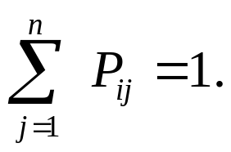
Markov chains
Sec. 21.2.1
Clearly, for all i,
Markov chains are abstractions of random walks.
Exercise: represent the teleporting random walk from 3 slides ago as a Markov chain, for this case:

Slide 26
Ergodic Markov chains
Sec. 21.2.1
For any (ergodic) Markov chain, there is a unique long-term visit rate for each state.
  Steady-state probability distribution.
Over a long time-period, we visit each state in proportion to this rate.
It doesn’t matter where we start.

Slide 27
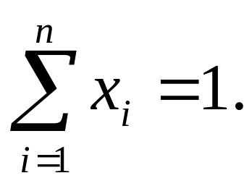
Probability vectors
Sec. 21.2.1
A probability (row) vector x = (x₁, … x_{n}) tells us where the walk is at any point.
E.g., (000…1…000) means we’re in state i.
1
i
n
More generally, the vector x = (x₁, … x_{n}) means the walk is in state i with probability x_{i}.

Slide 28
Change in probability vector
Sec. 21.2.1
If the probability vector is x = (x₁, … x_{n}) at this step, what is it at the next step?
Recall that row i of the transition prob. Matrix P tells us where we go next from state i.
So from x, our next state is distributed as xP
  The one after that is xP², then xP³, etc.
  (Where) Does the converge?

Slide 29
How do we compute this vector?
Sec. 21.2.2
Let a = (a₁, … a_{n}) denote the row vector of steady-state probabilities.
If our current position is described by a, then the next step is distributed as aP.
But a is the steady state, so a=aP.
Solving this matrix equation gives us a.
  So a is the (left) eigenvector for P.
  (Corresponds to the “principal” eigenvector of P with the largest eigenvalue.)
  Transition probability matrices always have largest eigenvalue 1.

Slide 30
Pagerank summary
Sec. 21.2.2
Preprocessing:
  Given graph of links, build matrix P.
  From it compute a – left eigenvector of P.
  The entry a_{i} is a number between 0 and 1: the pagerank of page i.
Query processing:
  Retrieve pages meeting query.
  Rank them by their pagerank.
  But this rank order is query-independent …

Slide 31
The reality
Pagerank is used in google and other engines, but is hardly the full story of ranking
  Many sophisticated features are used
  Some address specific query classes
  Machine learned ranking (Lecture 19) heavily used
Pagerank still very useful for things like crawl policy

Slide 32
Topic-Specific/Sensitive PageRank
PageRank computation with a teleport operation - the surfer jumps to a web page chosen uniformly at random.
Consider teleporting to a random web page chosen non-uniformly.
  Derive PageRank values tailored to particular interests.
  For instance, a sports aficionado might wish that pages on sports be ranked higher than non-sports pages.

Slide 33
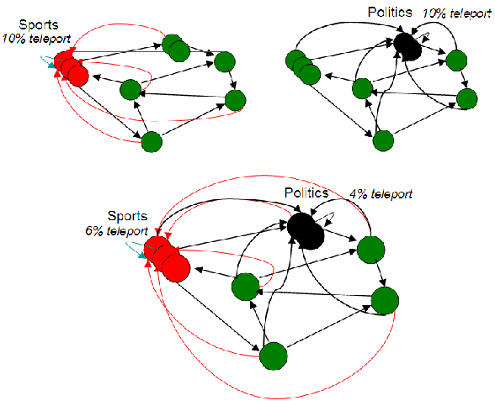


Topic-Sensitive PageRank

Slide 34
Hyperlink-Induced Topic Search (HITS)
Sec. 21.3
In response to a query, instead of an ordered list of pages each meeting the query, find two sets of inter-related pages:
  Hub pages are good lists of links on a subject.
    e.g., “Bob’s list of cancer-related links.”
  Authority pages occur recurrently on good hubs for the subject.
Best suited for “broad topic” queries rather than for page-finding queries.
Gets at a broader slice of common opinion.

Slide 35
Hubs and Authorities
Sec. 21.3
Thus, a good hub page for a topic points to many authoritative pages for that topic.
A good authority page for a topic is pointed to by many good hubs for that topic.
Circular definition - will turn this into an iterative computation.

Slide 36
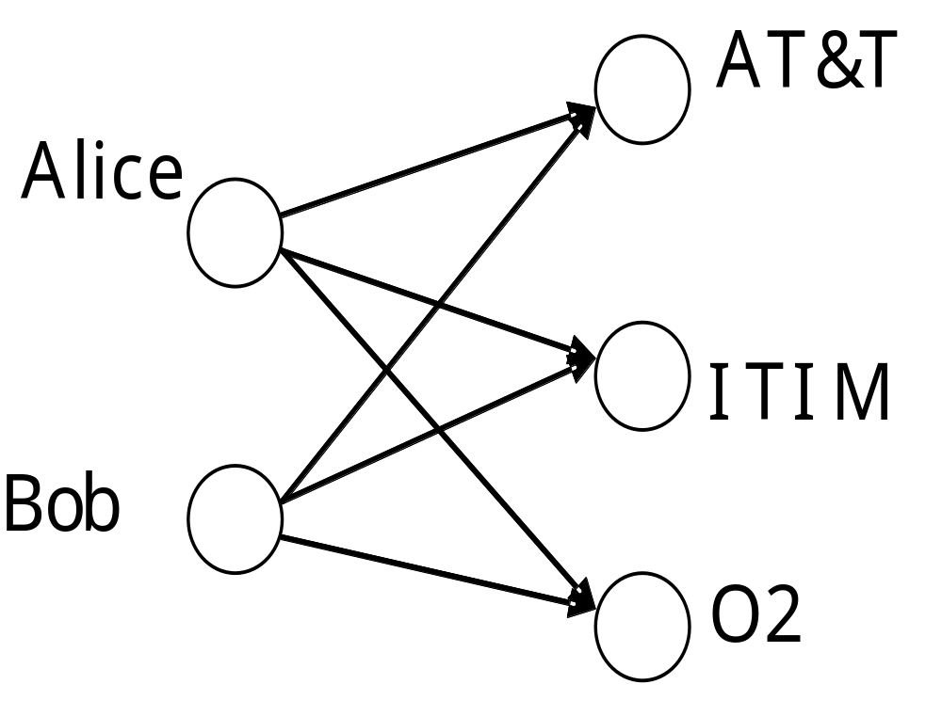
The hope
Sec. 21.3
Authorities
Hubs
Mobile telecom companies

Slide 37
High-level scheme
Sec. 21.3
Extract from the web a base set of pages that could be good hubs or authorities.
From these, identify a small set of top hub and authority pages;
  iterative algorithm.

Slide 38
Base set
Sec. 21.3
Given text query (say browser), use a text index to get all pages containing browser.
  Call this the root set of pages.
Add in any page that either
  points to a page in the root set, or
  is pointed to by a page in the root set.
Call this the base set.

Slide 39
Visualization
Sec. 21.3
Root
set
Base set
  Get in-links (and out-links) from a connectivity server

Slide 40
Distilling hubs and authorities
Sec. 21.3
Compute, for each page x in the base set, a hub score h(x) and an authority score a(x).
Initialize: for all x, h(x)←1; a(x) ←1;
Iteratively update all h(x), a(x);
After iterations
  output pages with highest h() scores as top hubs
  highest a() scores as top authorities.
Key

Slide 41
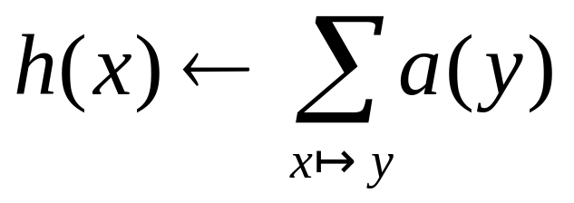
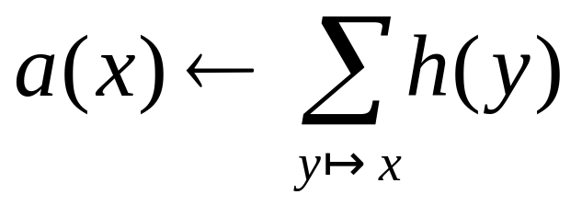
Iterative update
Sec. 21.3
Repeat the following updates, for all x:
x
x

Slide 42
Scaling
Sec. 21.3
To prevent the h() and a() values from getting too big, can scale down after each iteration.
Scaling factor doesn’t really matter:
  we only care about the relative values of the scores.

Slide 43
How many iterations?
Sec. 21.3
Claim: relative values of scores will converge after a few iterations:
  in fact, suitably scaled, h() and a() scores settle into a steady state!
  proof of this comes later.
In practice, ~5 iterations get you close to stability.

Slide 44
Japan Elementary Schools
Sec. 21.3
Hubs
Authorities
schools
LINK Page-13
“ú–{‚ÌŠwZ
a‰„¬ŠwZƒz[ƒƒy[ƒW
100 Schools Home Pages (English)
K-12 from Japan 10/...rnet and Education )
http://www...iglobe.ne.jp/~IKESAN
‚l‚f‚j¬ŠwZ‚U”N‚P‘g•¨Œê
ÒŠ—’¬—§ÒŠ—“Œ¬ŠwZ
Koulutus ja oppilaitokset
TOYODA HOMEPAGE
Education
Cay's Homepage(Japanese)
–y“ì¬ŠwZ‚Ìƒz[ƒƒy[ƒW
UNIVERSITY
‰J—³¬ŠwZ DRAGON97-TOP
Â‰ª¬ŠwZ‚T”N‚P‘gƒz[ƒƒy[ƒW
¶µ°é¼ÂÁ© ¥á¥Ë¥å¡¼ ¥á¥Ë¥å¡¼
The American School in Japan
The Link Page
‰ªès—§ˆä“c¬ŠwZƒz[ƒƒy[ƒW
Kids' Space
ˆÀés—§ˆÀé¼•”¬ŠwZ
‹{é‹³ˆç‘åŠw•‘®¬ŠwZ
KEIMEI GAKUEN Home Page ( Japanese )
Shiranuma Home Page
fuzoku-es.fukui-u.ac.jp
welcome to Miasa E&J school
_“ÞìŒ§E‰¡•ls—§’†ì¼¬ŠwZ‚Ìƒy
http://www...p/~m_maru/index.html
fukui haruyama-es HomePage
Torisu primary school
goo
Yakumo Elementary,Hokkaido,Japan
FUZOKU Home Page
Kamishibun Elementary School...

Slide 45
Things to note
Sec. 21.3
Pulled together good pages regardless of language of page content.
Use only link analysis after base set assembled
  iterative scoring is query-independent.
Iterative computation after text index retrieval - significant overhead.

Slide 46
Proof of convergence
Sec. 21.3
n×n adjacency matrix A:
  each of the n pages in the base set has a row and column in the matrix.
  Entry A_{ij} = 1 if page i links to page j, else = 0.
1 2 3
1
2
1
2
3
0 1 0
1 1 1
3
1 0 0

Slide 47
Hub/authority vectors
Sec. 21.3
View the hub scores h() and the authority scores a() as vectors with n components.
Recall the iterative updates

Slide 48
Rewrite in matrix form
Sec. 21.3
h=Aa.
a=A^{t}h.
Recall A^{t} is the transpose of A.
Substituting, h=AA^{t}h and a=A^{t}Aa.
Thus, h is an eigenvector of AA^{t} and a is an eigenvector of A^{t}A.
Further, our algorithm is a particular, known algorithm for computing eigenvectors: the power iteration method.
Guaranteed to converge.

Slide 49
Issues
Sec. 21.3
Topic Drift
  Off-topic pages can cause off-topic “authorities” to be returned
    E.g., the neighborhood graph can be about a “super topic”
Mutually Reinforcing Affiliates
  Affiliated pages/sites can boost each others’ scores
    Linkage between affiliated pages is not a useful signal

Slide 50
Connectivity servers

Slide 51
Connectivity Server
Sec. 20.4
Support for fast queries on the web graph
  Which URLs point to a given URL?
  Which URLs does a given URL point to?
Stores mappings in memory from
    URL to outlinks, URL to inlinks
Applications
  Crawl control
  Web graph analysis
    Connectivity, crawl optimization
  Link analysis

Slide 52
Boldi and Vigna 2004
Sec. 20.4
http://www2004.org/proceedings/docs/1p595.pdf
Webgraph – set of algorithms and a java implementation
Fundamental goal – maintain node adjacency lists in memory
  For this, compressing the adjacency lists is the critical component

Slide 53
Adjacency lists
Sec. 20.4
The set of neighbors of a node
Assume each URL represented by an integer
E.g., for a 4 billion page web, need 32 bits per node
Naively, this demands 64 bits to represent each hyperlink

Slide 54
Adjaceny list compression
Sec. 20.4
Properties exploited in compression:
  Similarity (between lists)
  Locality (many links from a page go to “nearby” pages)
  Use gap encodings in sorted lists
  Distribution of gap values

Slide 55
Storage
Sec. 20.4
Boldi/Vigna get down to an average of ~3 bits/link
  (URL to URL edge)
How?
Why is this remarkable?

Slide 56
Main ideas of Boldi/Vigna
Sec. 20.4
Consider lexicographically ordered list of all URLs, e.g.,
  www.stanford.edu/alchemy
  www.stanford.edu/biology
  www.stanford.edu/biology/plant
  www.stanford.edu/biology/plant/copyright
  www.stanford.edu/biology/plant/people
  www.stanford.edu/chemistry

Slide 57
Boldi/Vigna
Sec. 20.4
Each of these URLs has an adjacency list
Main idea: due to templates, the adjacency list of a node is similar to one of the 7 preceding URLs in the lexicographic ordering
Express adjacency list in terms of one of these
E.g., consider these adjacency lists
  1, 2, 4, 8, 16, 32, 64
  1, 4, 9, 16, 25, 36, 49, 64
  1, 2, 3, 5, 8, 13, 21, 34, 55, 89, 144
  1, 4, 8, 16, 25, 36, 49, 64
Why 7?
Encode as (-2), remove 9, add 8

Slide 58
Gap encodings
Sec. 20.4
Given a sorted list of integers x, y, z, …, represent by x, y-x, z-y, …
Compress each integer using a code
  γ code - Number of bits = 1 + 2 ⎣lg x⎦
  δ code: …
  Information theoretic bound: 1 + ⎣lg x⎦ bits
  ζ code: Works well for integers from a power law Boldi Vigna DCC 2004

Slide 59
Main advantages of BV
Sec. 20.4
Depends only on locality in a canonical ordering
  Lexicographic ordering works well for the web
Adjacency queries can be answered very efficiently
  To fetch out-neighbors, trace back the chain of prototypes
  This chain is typically short in practice (since similarity is mostly intra-host)
  Can also explicitly limit the length of the chain during encoding
Easy to implement one-pass algorithm

Slide 60
Resources
IIR Chap 21
http://www2004.org/proceedings/docs/1p309.pdf
http://www2004.org/proceedings/docs/1p595.pdf
http://www2003.org/cdrom/papers/refereed/p270/kamvar-270-xhtml/index.html
http://www2003.org/cdrom/papers/refereed/p641/xhtml/p641-mccurley.html
The WebGraph framework I: Compression techniques (Boldi et al. 2004)

Slide 61
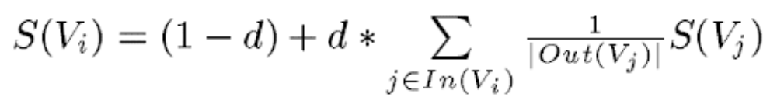
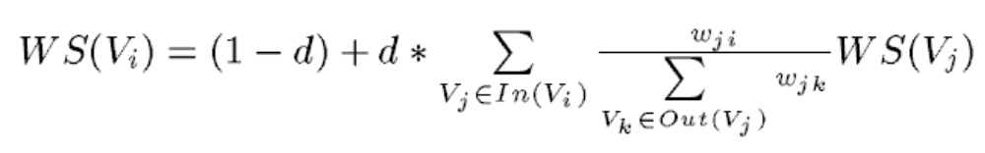
TextRank = weigthed PR
PageRank:
Weighted graphs:

Slide 62
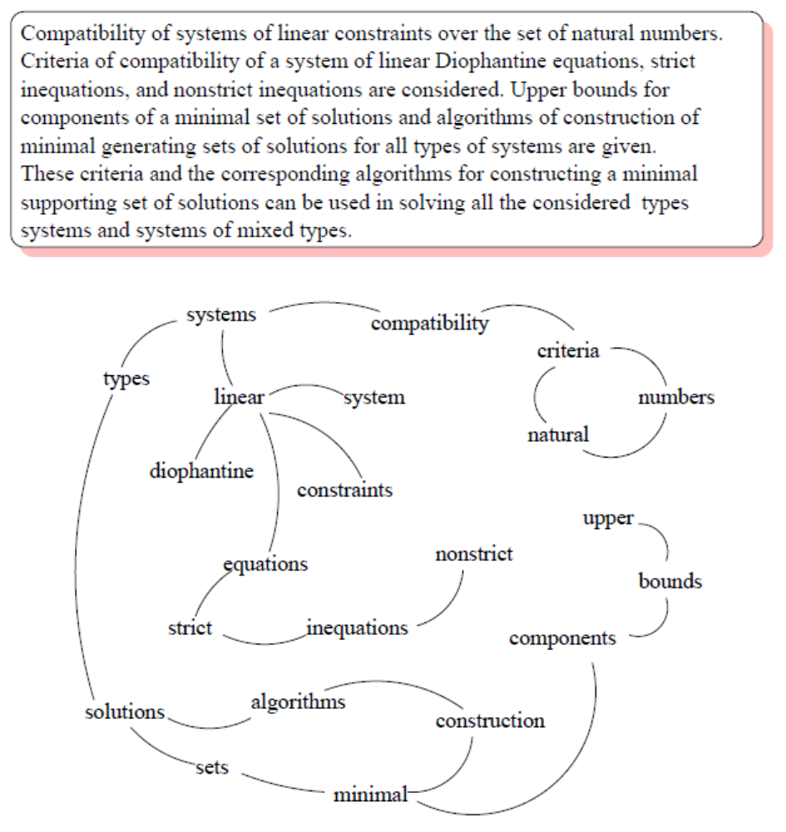
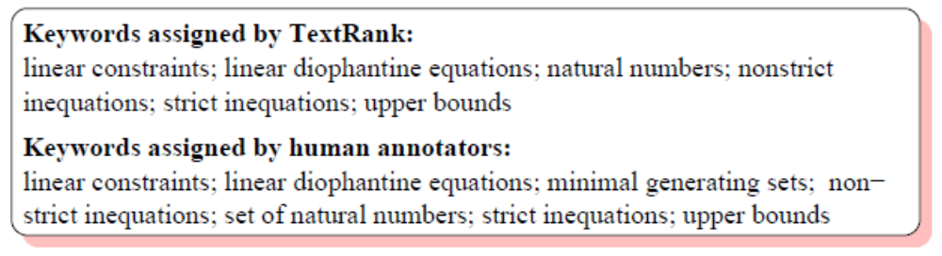
Text as a graph: Word graph

Slide 63
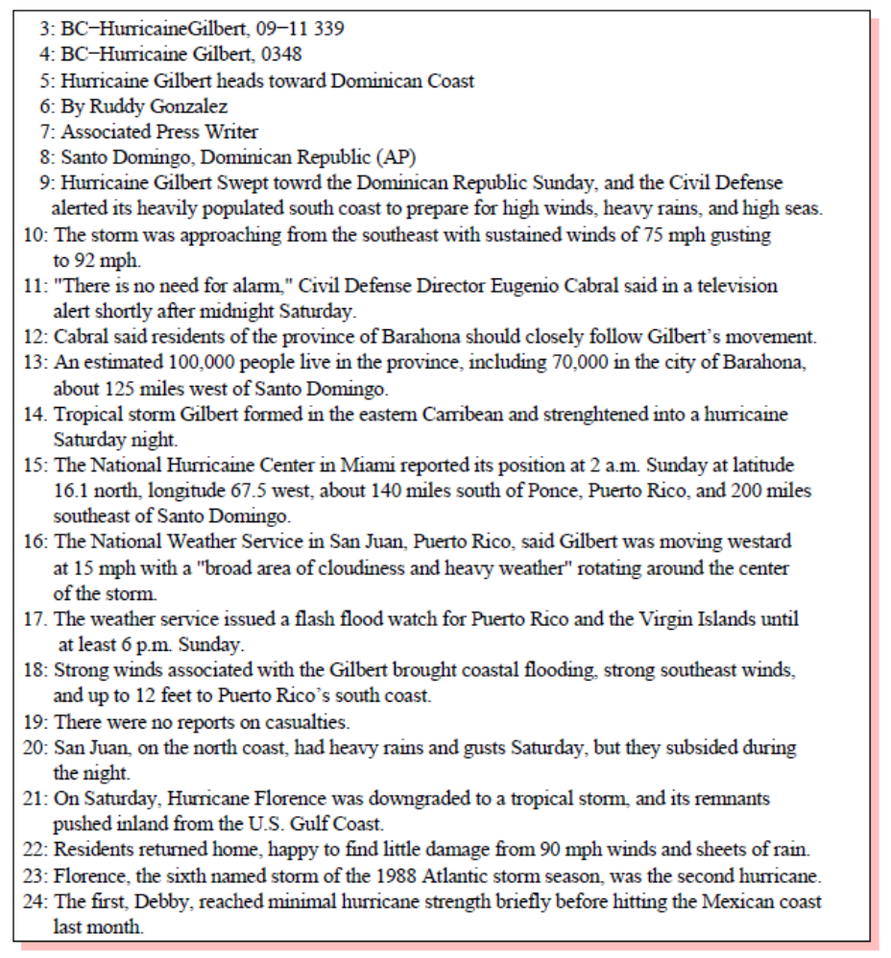
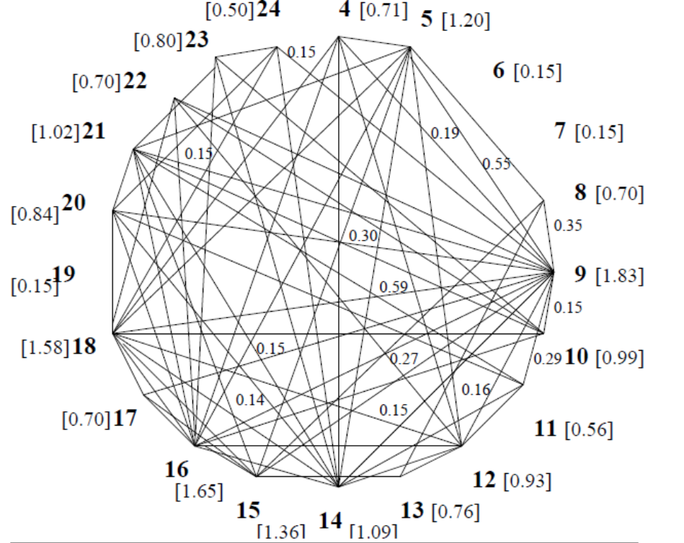
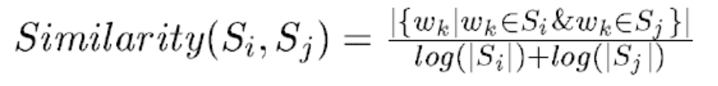
Text as a graph: sentence graph

